Slide 1
PS6 tips

Slide 2
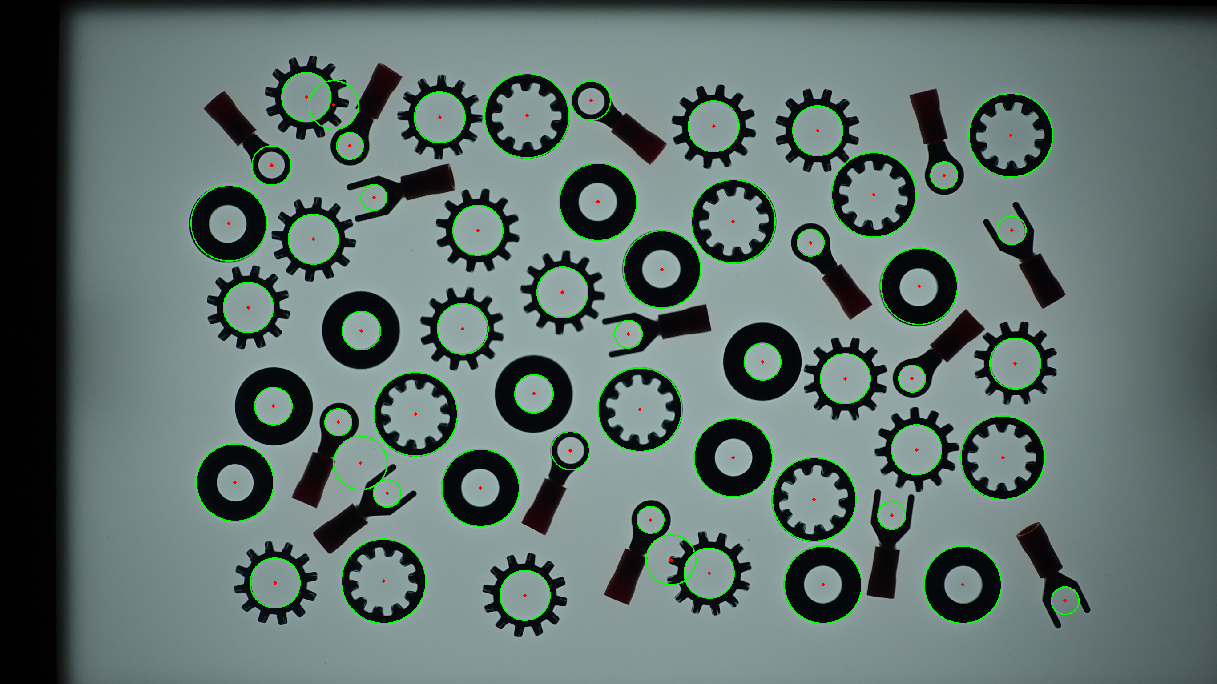
Circle/Line Detection
Hough transform algorithm
It is difficult to use OpenCV implementation
Same center circle
Circle size needs to specify
Separate circle/line matching (noise)
Practical solution
Contour Detection
Length (2πr)
Area (πr²)

Slide 3
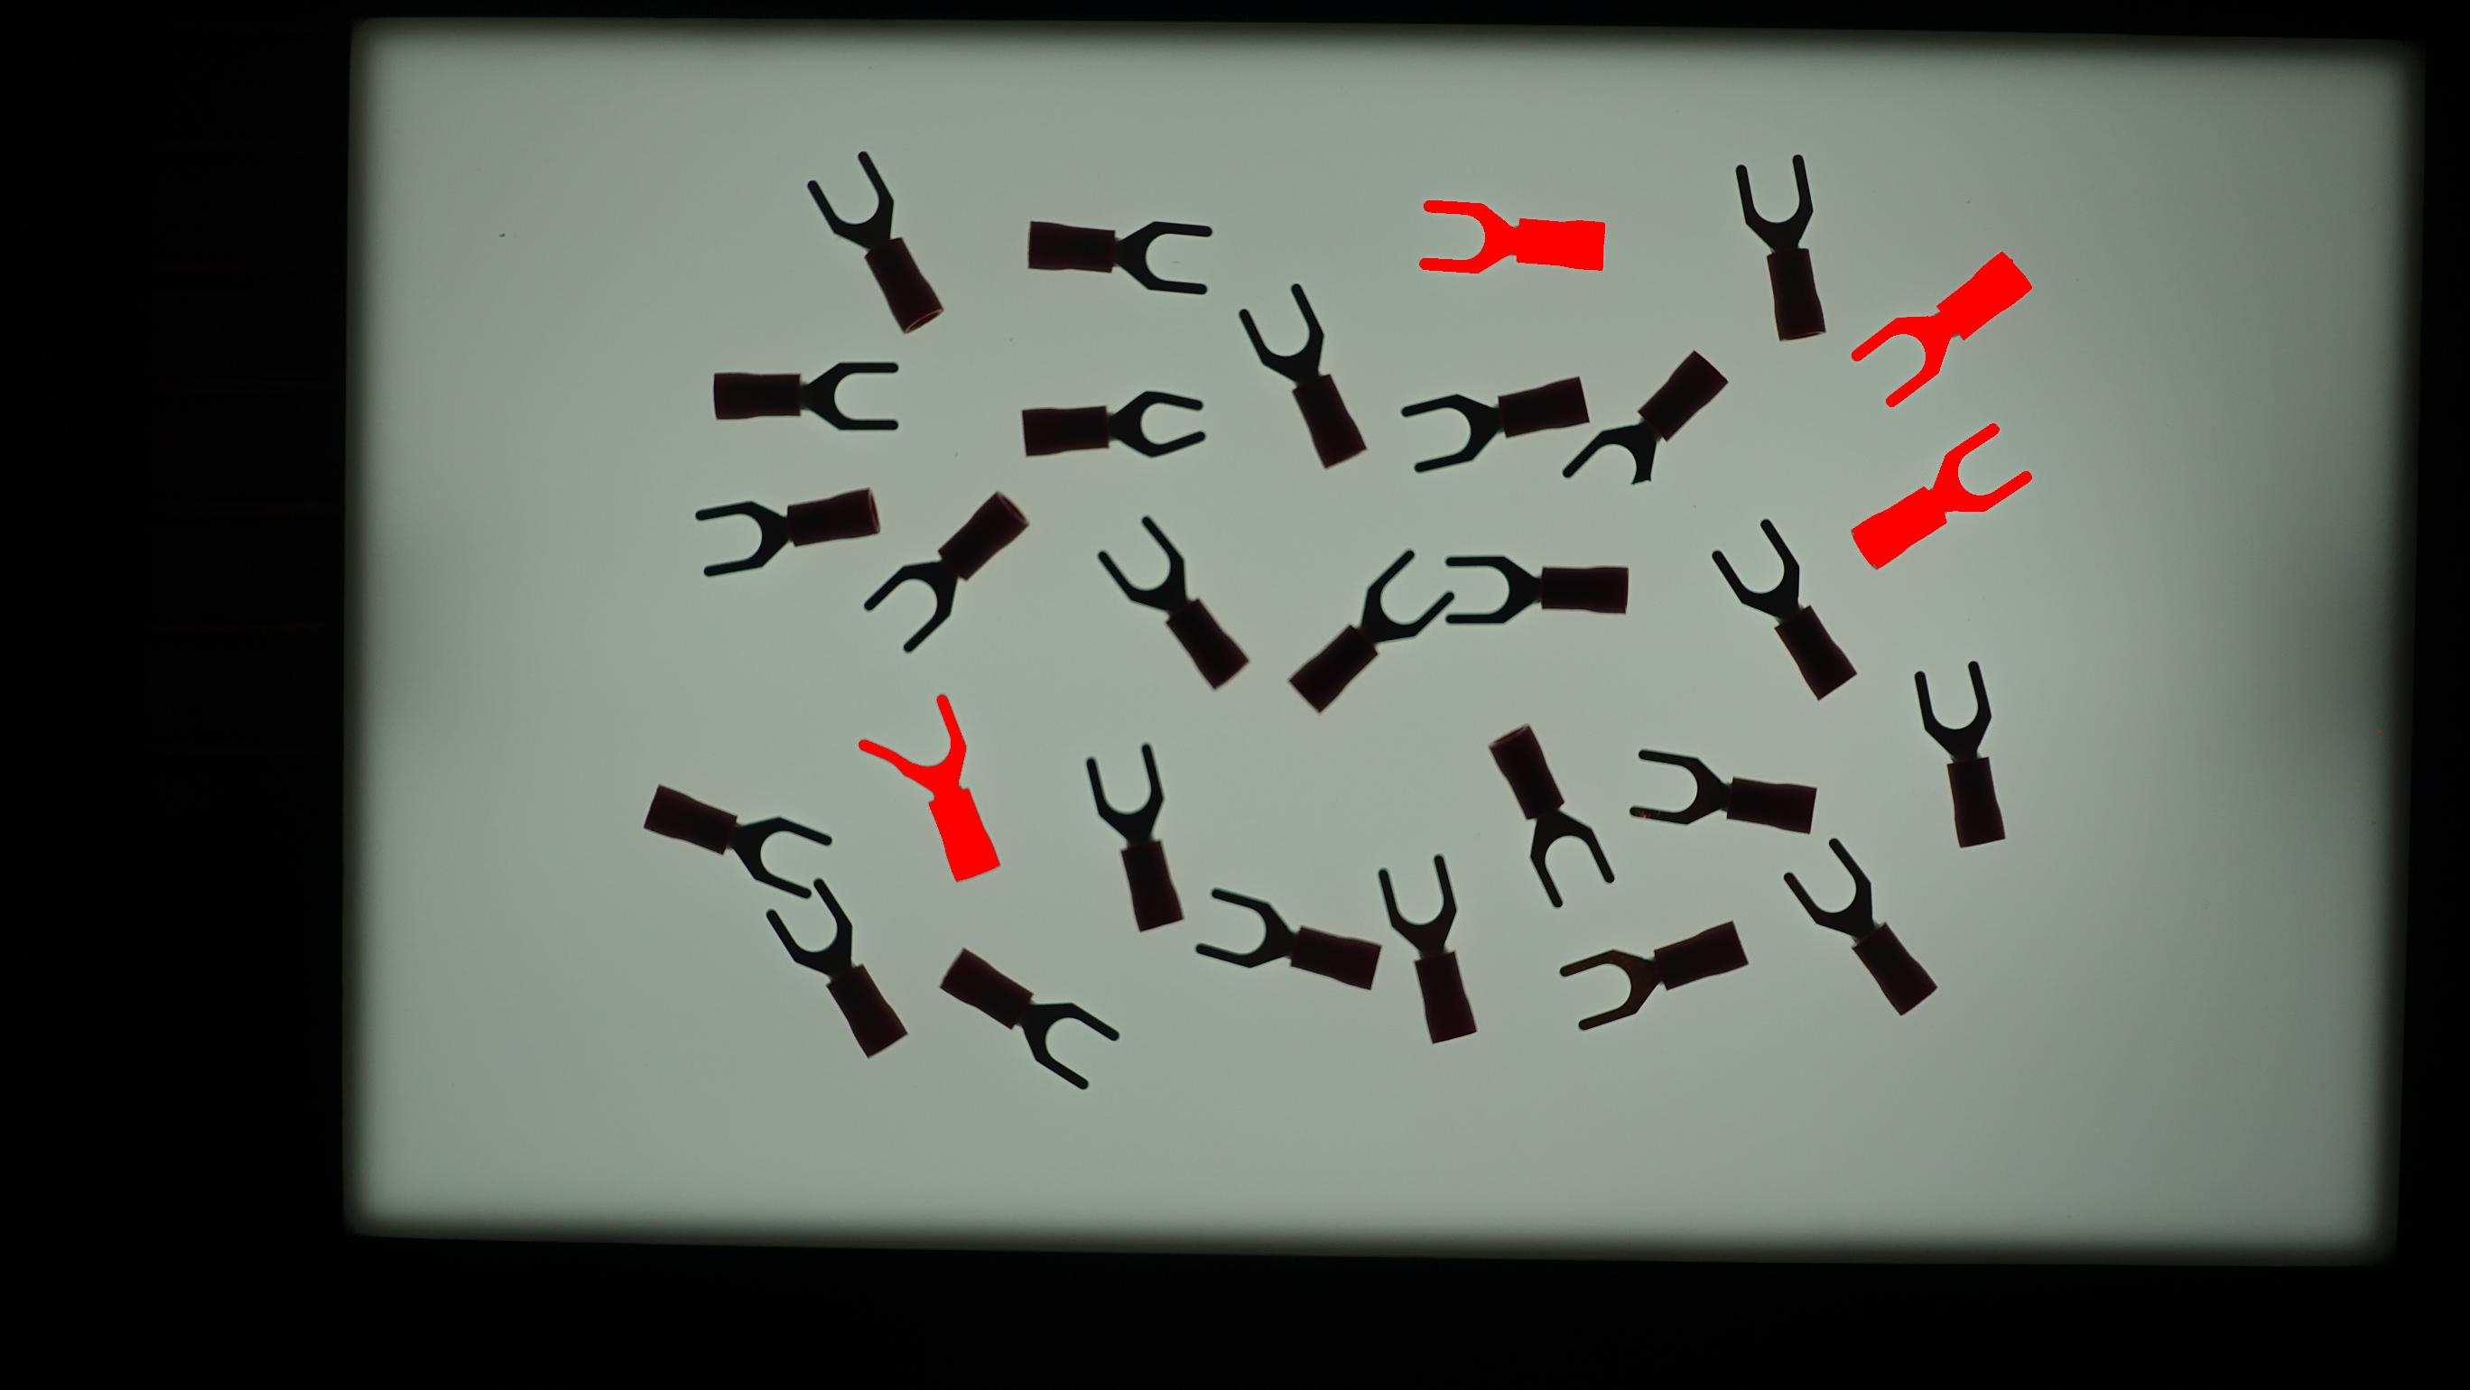
Template matching limitation
Requirement
Same/similar size
Better on grayscale or pattern
Pattern matching not shape matching

Slide 4
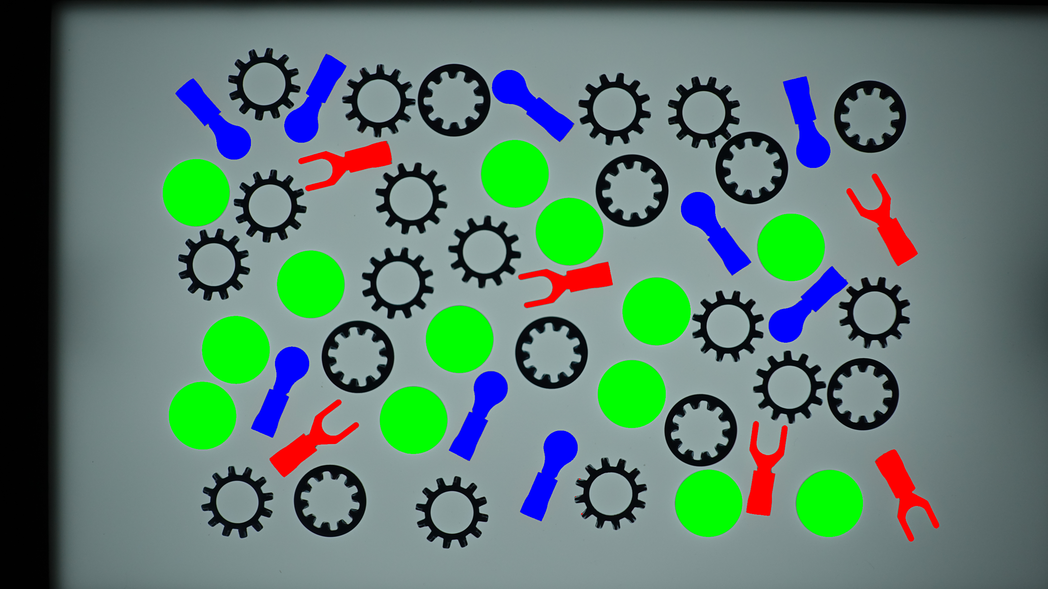
3parts.py
Current Status
Separation (not complete) of image
Opening (E->D), multiple?
Number of contour lines
Bounding box shape
You need to complete in/out gear separation

